Slide 1

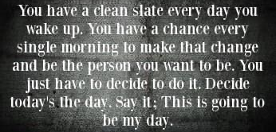
Impact Report 2023-24
Registered Charity number: 1197726

Slide 2

Mission
"The purpose of Clean Slate is to provide long-term emotional support for male and female survivors of abuse in the UK, particularly in Cherwell and wider Oxfordshire. We aim to encourage individuals to explore their own mental health needs and adopt positive coping strategies for long-term recovery. Our goal is to support men, women, and their families who have been victims or witnesses of domestic, sexual, mental, emotional, and financial abuse."

Slide 3
Achievements this year
Partnership with Brookes University - We have taken on 2 trainee social workers to do their placements
366 New Referrals
3265 Counselling hours provided
79 Qualified/Trainee Counsellors volunteering for us
295 clients accessed counselling
Updated our client management system

Slide 4
Growth over the last 4 years

Slide 5
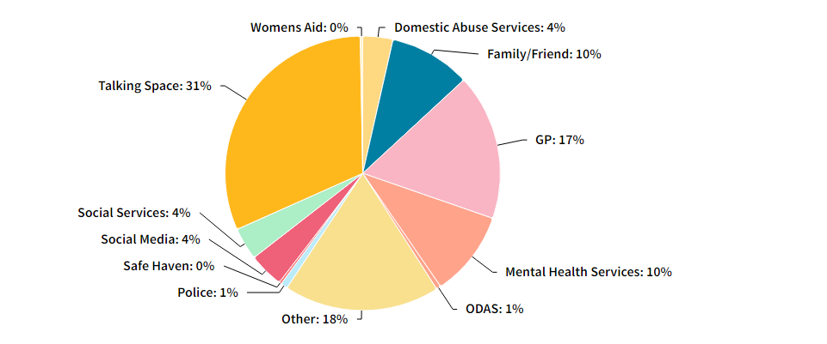
Referral sources

Slide 6
“
When I started the process of looking for help I really thought what I needed was a rigid, step focused, quick-fix approach to my problems because that is my job and the way I tend to approach most things. I was shocked to realise that all I needed and wanted was someone that I could trust to ask how I was feeling and to help me understand myself. I felt immediately comforted by Poppi’s energy and felt like I could trust her straight away when talking about very difficult topics. Poppi is very present in the sessions and will often pick up on small details from previous sessions which makes me feel very heard and something I really appreciated. Her holistic approach was completely new to me and, whilst it helped me to process my main problems, I genuinely believe I will be using these skills and ways of thinking for the rest of my life for (probably) all aspects of my life. Poppi is very authentic and I don’t feel like I am a subject or client, I feel like I am talking to a non-judging, neutral, listening ear who will pick up on her own energy and mine when discussing different things. This can be extremely validating for someone who has never felt very validated. From Poppi I have learnt about trusting your gut, checking in on yourself, grounding techniques and being ok with setting boundaries to name a few tools. I had one session per week with Poppi but when I had a particularly challenging week she made herself very available to have another, last minute session which I was very grateful for. Poppi has changed my life and I feel incredibly lucky that our paths met and only wish that others can find her as I did.

Slide 7
“
I wanted to take this opportunity to thank you and the team and to say how amazing it is that you are able to offer these services to people who need it and for as long as they need them. This has made a huge difference to both of these clients in particular and I have seen them grow and look to positive futures. They are both young and I hope having been brave enough and able to access the therapy early in their lives they will go on to have very happy futures.

Slide 8
Grants & Charitable Trusts
J A Pye | £ 1,000.00
Albert Hunt | £ 2,000.00
Asda Foundation | £ 450.00
Oxfordshire Community - OCVA | £ 3,000.00
Doris Field | £ 1,000.00
Lottery | £ 10,000.00
Co-op | £ 763.36
Platform Housing | £ 3,200.00
Magdalen Hospital | £ 2,000.00
Souter Charitable Trust | £ 4,000.00
Bartlett Taylor | £ 500.00
J A Pye | £ 1,500.00
TCPCC Community Fund | £ 5,000.00
June 2024

Slide 9
Parish & Town Councils
Cumnor Parish Council
Launton Parish Council
Kennington Parish Council
Lewknor Parish Council
Wallingford Town Council
Tetsworth Parish Council
Steeple Barton Parish Council
Eye & Dunsden Parish Council
Easr Hagbourne Parish Council
Bletchingdon Parish Council
Chalgrove Parish Council
Crowmarsh Parish Council
Stanford Parish Council
Drayton Abingdon Parish Council
Witney Town Council
Bix & Assen Parish Council
Harwell Parish Council
Aston Cote Shifford Parish Council
Appleton with Eaton Parish Council
East Hendred Parish Council
Forest Hill with Shotover Parish Council
Uffington Parish Council
Caversfield Parish Council
Heyford Park Parish Council
Abingdon Town Council
Didcot Town Council
Chipping Norton Town Council
Faringdon Town Council
Hinton Waldrist PA
Croperdy Parish Council
June 2024

Slide 10
Goals for 2024-25
Business priorities
Employee opportunities
Gain TST Standards
Increase fundraising income
Promotion of self-paced courses
Using social media to promote our services
Update our Volunteer Management System
Improve male service provisions
Develop a Youth Provision
Train more Peer support workers
Ensure all volunteers and staff have completed all statutory and mandatory training, to improve their abilities and enhance their experience with the charity

Slide 11
Long Term Goals
Goal 1
Goal 2
Goal 3
Goal 4
Sourcing and securing additional space for counselling face to face
Funding strategy for a new premises
Become self-funded to avoid relying on time-consuming grant access.
Youth Provisions

Slide 12
Summary
Our Charity is achieving its objectives
We have spent the past year Suring up our policies and procedures, and working towards achieving a service standard in line with other charities in the sector
We’re delivering for our clients
Last year we supported 366 clients with long term support
We put our clients first.
We are managing our waiting lists and supporting clients whilst they wait.
Our clients give excellent feedback
Our clients always give positive feedback
Our lived experience leadership team and volunteers, deliver a service that we are proud of.
Every person who accesses our service has the opportunity to give back.

